Slide 1
Unit 4 Hypothesis testing

Slide 2
Learning objectives
Parametric Hypothesis Testing, Finite Sample Sizes, and Chi-Squared and Student's T Distributions
At the end of this lecture, you will be able to do the following:
Test hypotheses when the i.i.d. data samples have a Gaussian distribution.
Recognize when you cannot assume the test statistic to be approximately Gaussian (in the small sample sizes regime).
Understand, recognize, and use the Chi-Squared Distribution .
Use the Cochran's Theorem , which relates the sample variance and sample mean when the data samples are i.i.d. Gaussian.
Understand, recognize, and use the Student's T Distribution ; understand when the test statistic follows a Student's t distribution in finite samples.
Test hypotheses in the small sample sizes regime when the i.i.d. data samples have a Gaussian distribution.
Understand convergence of the Student's t distribution to the standard normal distribution as the sample size increases.

Slide 3
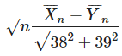
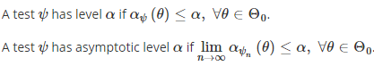
Recap and
We discussed what is 1) H0 and Ha hypotheses are, 2) type 1 and type 2 errors, 3) level (alpha) and power (1-alpha) 4) p-values and our tests were based on CLT
Some earlier facts: 1) Linear combination of Gaussians is Gaussian 2)
When we know mean and var of X and Y, the mean and variance of distribution is exact; however, when we estimate mean and variance based on sample we can only talk about its convergence by using Law of Large numbers and Slutsky’s theorem 3) Level of a test is the worst case scenario for alpha (for given n), whereas asymptotic level is a worst case scenario when n -> infinity
Our earlier tests were mostly asymptotic (CLT, LLN),So that we can use Gaussians

Slide 4
Goals for next lectures
First new case we will analyze is when distribution is Gaussian but variance is unknown, although in this case there is no need for CLT, we still need some replacement for Slutsky to estimate variance- in this case we use T-test
2nd case is when we have multiple parameters to estimate and they are not means of some distributions, so we cannot use multivariate CLT, in this case we can use asymptotic results of MLE estimator, this is called Wald’s test
Other example is when we do tests on multivariate parameters
such as whether
All of tests described so far were for parametric models (we conducted tests on some single var or multi var parameters and 1 to 1 correspondence between param and distrib
4. More complex tests such as testing whether assumed distribution is correct (e.g. Does my data follow a Gaussian distribution?) – called goodness of fit tests, for PMFs we will use chi-squared tests
Test about PDF is not parametric, we do not estimate a finite dimensional parameter

Slide 5

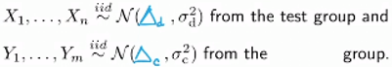
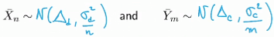
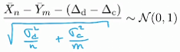
Parametric Hypothesis Testing
Let’s do clinical trials to estimate whether the effect of a particular drug is statistically significant
Let delta_d>0 denote the expected decrease of LDL level for a patient that has used the drug
Let delta_c>0 d denote the expected decrease of LDL level for a patient that has used the placebo
We want to know if
We observe 2 independent samples
So our Hypotheses are:
Since the data is Gaussian by assumption, we do not need the CLT
We have individual distributions
Therefore for p-value:
But we do not know variances of X and Y, we can replace them with sample var using Slutsky

Slide 6
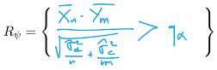
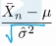
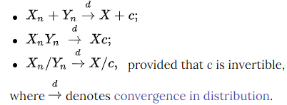
Hypothesis test example continued
We do not know delta_d and delta_c, but under H0 they should be equal
We get the following test at asymptotic level alpha
If n and m are small, say, <30 , then we cannot use
Slutsky, as it requires n-> inf, this works only asymptotically, sample var -> var if n is large
Slutsky allowed us to talk about distribution of transformed Gaussian

Slide 7
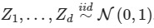
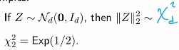
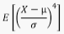
The Chi-Squared Distribution and its Properties
is given by:
A
Chi squared distrib is only specified with 1 (positiv) parameter - d (degrees of freedom)
With increase in d, the mean and variance increases
3rd moment determines skewness ( 0 if symmetric)
4th moment determines kurtosis (heaviness of tails; for Z (std normal) it equals to 3)
We check kurtosis by comparing its to kurtosis of Z - 3
E[Chi]=d; var(Chi)=2*d; so std is in order of sqrt(d)

Slide 8
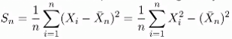
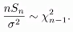
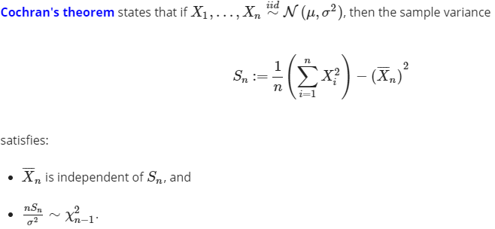
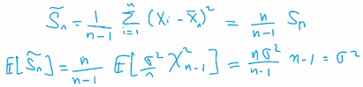
Cochran's Theorem: Independence of Gaussian Sample Variance and Sample Mean
Sample variance is given by:
Cochran’s theorem states that for Sn is the sample variance then sample mean and sample variance are independent for all n
Scaled version of sample variance has Chi-square distribution, n-1 degrees of
Freedom, because the sum is 0 with n components

Slide 9
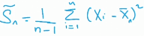
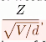
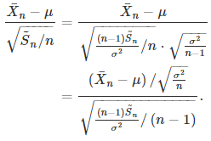
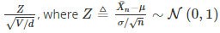
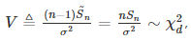
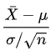
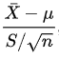
Student’s t distribution
Sample variance is shown on RHS; X-mu/std is standard normal
For a positive integer d, the Student’s t distribution with d degrees of freedom (td) is the law of the random variable where
V is a sample mean
Standard normal vs Student’s T distribution: vs (n-1 degrees of freedom and X_bar and S should be uncorrelated)

Slide 10
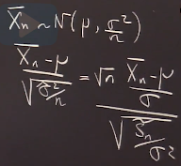
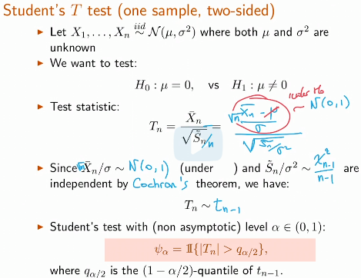
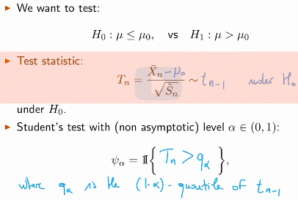
The T Test - One Sample, Two-Sided

Slide 11
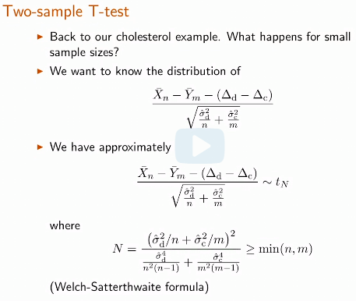
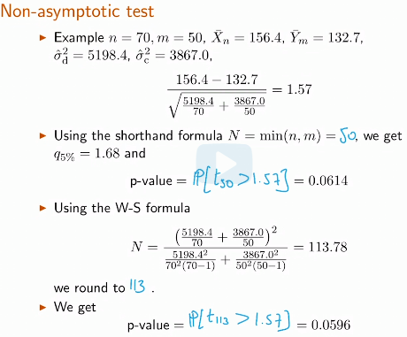
Clinical Trials - Two Sample T-Test and the Welch-Satterthwaite Formula

Slide 12
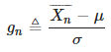
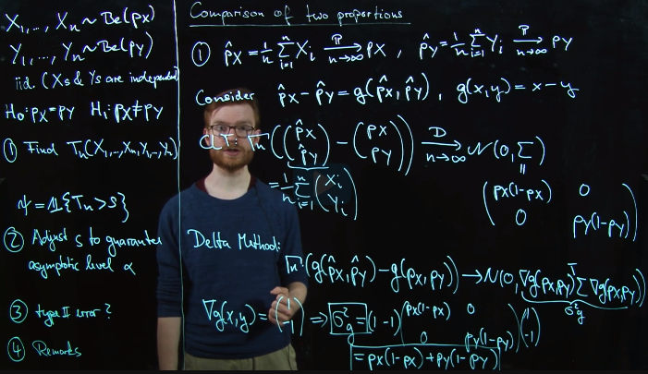
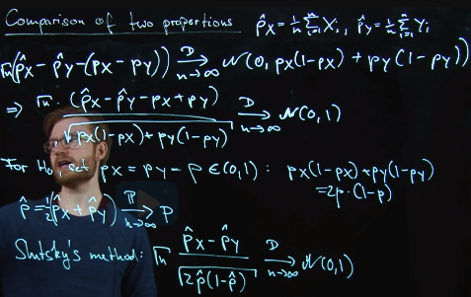
Recitation 12. Comparison of 2 proportions
You are inter in compar the prop of people in their 20's that smoke in France and in the US
Pivot or pivotal quantity is a random variable whose distribution is the same for all theta’s
Setup and Asymptotic Variance The Test Statistic

Slide 13
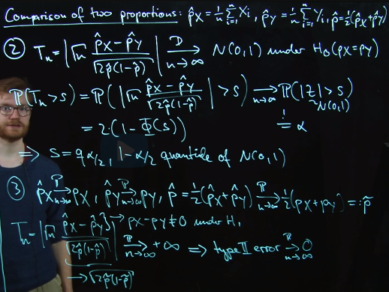
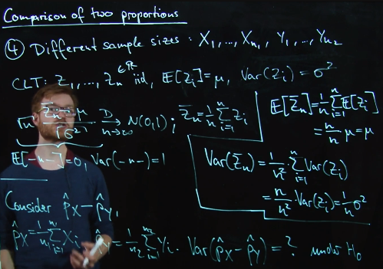
Recitation. Comparison of 2 proportions
Threshold, Level, and Type 2 Error Concluding Remarks
1) If H0 does not hold, T -> inf, so T will exceed any fixed limit qalpha, so type2 error =0
2) Different sample sizes n1 and n2

Slide 14
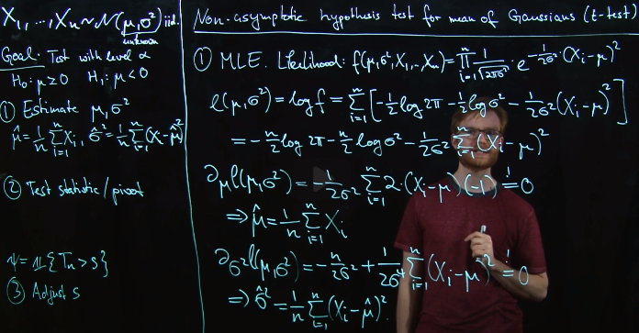
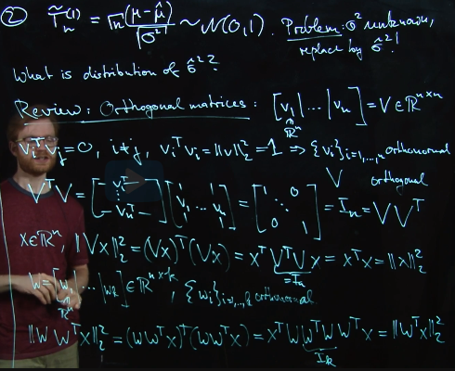
Proof of Cochran's Theorem and T Test
MLE for Gaussian variables
Orthogonal matrix is a square matrix whose columns and rows are orthogonal unit vectors (orthonormal vectors)

Slide 15
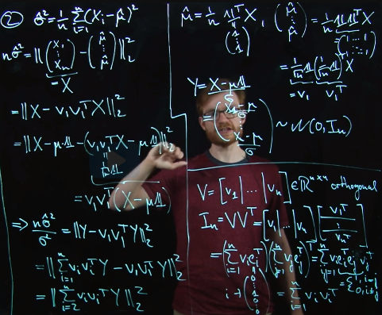
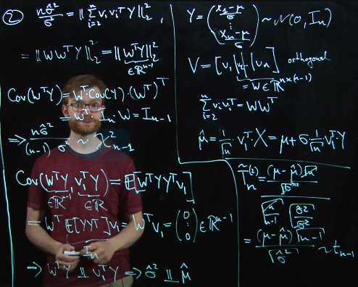
Recitation 13. Proof of Cochran's Theorem and T Test
Sample Variance as a Norm Chi Squared Distribution

Slide 16
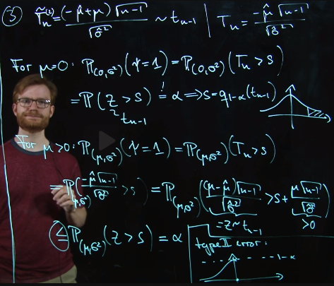
Recitation 13. Proof of Cochran's Theorem and T Test
T-test

Slide 17
Wald's Test, Likelihood Ratio Test, and Implicit Hypothesis Test
At the end of this lecture, you will be able to do the following:
Derive Wald’s test using the properties of multivariate Gaussians
Perform Wald’s test for a family of hypothesis testing questions
Perform the likelihood ratio test for a family of hypothesis testing
Use an asymptotically normal estimator to test implicit hypotheses involving an unknown parameter

Slide 18
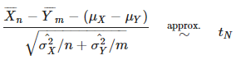
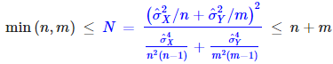
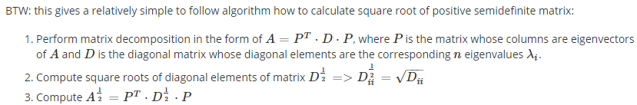
T-test
Statistic for t-test is calculated as follows:
To find degrees of freedom in T distribution we use Welch-Satterwaite formula, which is in the range
Advantage of Student’s test: 1) non-asymptotic, so can be run on small samples 2) we can use it always- if sample is small then we should assume data is Gaussian, if large even if not gaussian data, CLT will kick in- one size fits all
Disadvantage: It relies on the assumption that the sample is Gaussian

Slide 19
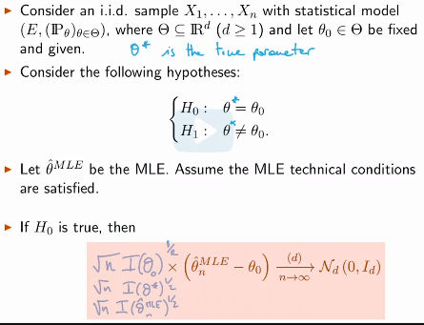
Introduction to Wald's Test
Test based on MLE
As in MLE we have convergence to
Inverse Fisher information we should
Multiply by I^1/2 it to cancel to identity
If estimator MLE is consistent we can
Plug in also MLE
For any orthogonal matrix M, MZ is also a standard multivariate Gaussian vector if Z is a standard multivariate Gaussian

Slide 20
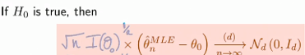
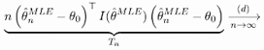
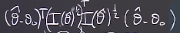
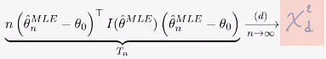
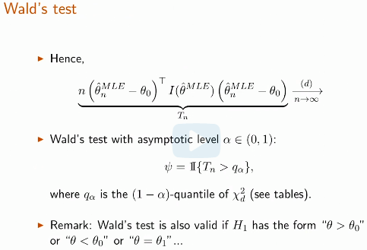
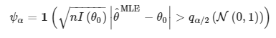
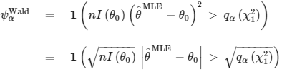
Wald's Test Continued
We said earlier if theta_MLE is close to theta_0 then the length of vector should be small, to find the length of vector we find its norm
So, Wald’s test is about the length of this vector
and I is symmetric
So, overall multiplication converges to Chi squared distribution with d deg of freed.

Slide 21
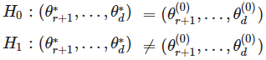
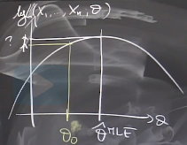


Likelihood Ratio Test
We are deciding between 2 hypotheses:
Setting subset of parameters under H0 equal to something
So, using MLE we will find theta’s for specified param under H0
The likel ratio test is a natural test in a sit where we only care about
Some of the unknowns involved in the parameter theta (last d-r)

Slide 22


Implicit Hypothesis Testing and the Delta Method
Implicit hypothesis Delta method

Slide 23

Implicit Hypothesis Testing and the Delta Method
We put theta_hat because we do not know theta0 (point at which covariance matrix is evaluated), we know only g(theta_0)=0

Slide 24


Recitation. Wald's Test versus Likelihood Ratio Test
Wald’s test is based on square of normalized MLE test
Likelihood ratio test is based on ratio of L(H1)/L(Ho) >c we take log of both sides

Slide 25


Recitation. Wald's Test versus Likelihood Ratio Test
a

Slide 26
Lecture 15. Goodness of Fit Test for Discrete Distributions
At the end of this lecture, you will be able to do the following:
Understand the difference between parameter estimation, parametric hypothesis testing, and goodness of fit testing.
Know when and how to apply a goodness of fit test for discrete distributions.
Understand the categorical distribution , compute probabilities associated with it, and know how to compute likelihoods for a categorical distribution.
Use the maximum likelihood estimator for the categorical distribution.

Slide 27

Goodness of Fit Tests: Motivation
Goodness of fit tests are non-parametric tests (H0 is like parametric, but Ha is everything else)
Let X be a r.v. Given iid copies of X we want to answer the following type of quest
Does X have distribution N(0,1) 2) or U(0,1) or PMF p1=0.3, p2=0.5, p3=0.2
These are all goodness of fit tests
For testing PMF we can explore following
Problem: is this distribution matches proportion
Of races in population that is p1,p2,p3… = to certain number or there is statistical significance that the data obtained here is statistically diff (not due to random sampling)
The histogram is a useful tool for gaining intuition as to what distribution the data follows. In the remainder of this unit, we will develop more rigorous methods to examine whether a particular data set is drawn from a given distribution.
In parametric hypothesis testing we set H0 to some particular distribution in the family of certain P distributions, that is we limit what alternative distributions can be, but in non-parametric (goodness of fit tests) we do not impose any limit

Slide 28



The Probability Simplex
A1… ak are set of possible
Values that parameters within
Random variable can take
Delta_k is the vector of all possible
Values that parameter vector can take
So, prob simplex is when parameter is vector in Rk
We can use Wald’s test (which is based on MLE) or likelihood ratio to test whether p=p0
To apply these methods we need PMF/PDF (for Wald we need Fisher I; for LR likelihood f)

Slide 29







The Goodness of Fit Test: Categorical Likelihoods
Categorical is to Bernoulli,
as in Multinomial is to Binomial.
Multinomial
Categorical
The maximum likelihood estimator will form the basis of goodness of fit testing for discrete distributions.
MLE for categorical
K-1 unknows
K-1 equations

Slide 30


Chi-Squared Test for Testing Goodness of Fit of Discrete Distributions
Why k-1 degrees of freedom because our vector is orthogonal to [1,1] vector, as sum of p’s in PMF sum up to 1, so no variance in that direction
2 main points with test statistic
We divide by p not p(1-p) (lower value of test statistics, more conservative)
Distribution has k-1 degrees of freedom (lower critical value to reject, less conservative

Slide 31





Chi-square vs Wald’s test
Wald’s test:
Chi-square test:
chi-square test is used to determine whether there is a statistically significant difference between the expected frequencies and the observed frequencies in one or more categories of a contingency table
Wald’s test is based on MLE to do hypothesis testing on parameters that are represented by a vector, if Ho is true then
Length of the vector should be small and
Z^2 -> Chi square distribution

Slide 32

Chi-Squared Test for a Family of Discrete Distributions
a

Slide 33


Recitation 15. Chi-Squared Goodness of Fit Test
Suppose we have X1,…, Xn iid with a discrete and finite sample space and we wish to perform hypothesis tests to
Task 1: Understand whether the data was generated with a distrib with a particular PMF p0
Task 2: Underst. whet data was gener with a distrib of a family of distrib
Categorical statistical model (k discrete outputs, each have some probability pk)
Probability simplex is when we have p in Rk 1) ps add to 1 2) all p’s >0
In Chi-square goodness of fit test based on some number of copies of iid X
We would like to know if H0: p=p0 or H1: p!=p0

Slide 34


Reparameterization of the Categorical Statistical Model
We cannot apply Wald’s test in its usual
form because in p vector the final pn
equals to linear combination of earlier p’s
and in this case our Fisher inf matrix is
non-invertible
So, we reparametrize and instead define
New p, p- (k-1) dimensional vector
Not including the vector that is linear
Combination of others
After doing this we apply Wald’s
Test and it turns out to be Chi-squared
Test
So, overall the only difference is that we change p to p-

Slide 35

MLE and Fisher Information of the Reparametrized Model
So having changed p to p-,
That is from k to k-1 dimensional
Vector, now we apply Wald’s test
For that we need 1) p^ - MLE estim
Of p 2) Fisher information evaluated
At p^
We plug these values and compute
Test statistics

Slide 36


The Chi-Squared Test Statistic and Asymp Chi-Squared Distrib from Wald's Test
So, if in Wald’s test instead of k dimensional parameter vector p, we use k-1 dimensional vector (so that FI is computable) this leads to Chi-squared test with k-1 degrees of freedom

Slide 37

Generalization of Chi-Squared Test to a Family of Discrete Distributions
Not equal to particular p0 but to a family of distributions (Binomial, Poisson etc)

Slide 38
Lecture 16: Goodness of Fit Tests Continued: Kolmogorov-Smirnov test, Kolmogorov-Lilliefors test, Quantile-Quantile Plots
At the end of this lecture, you will be able to do the following:
Compute the empirical cumulative distribution function for a given sample.
Perform the Kolmogorov-Smirnov test to determine if a dataset has a particular type of distribution.
Perform the Kolmogorov-Lilliefors test to test if a sample has a Gaussian distribution.
Construct and interpret the quantile-quantile (QQ) plot of a data set.
Compare and contrast the Kolmogorov-Smirnov test, Kolmogorov-Lilliefors test, and the chi-squared goodness of fit test.

Slide 39







Goodness of fit test; Empirical CDF
Goodness of fit test (non-parametric) – data comes either from specific distrib or not
In discrete case: PMF p H0: p=p0; H1: p!=p0 we use Chi-sq test with k-1 deg of freedom
In continuous case: pdf f (such as Gaussian) H0: f0 H1 not f0, clearly chi-sq test does not work because number of deg of freedom is infinite
One option is to convert PDF into PMF by introducing bins and sorting sample space intro discrete intervals and apply Chi-square test (is my data coming from this histogram)
Parameters to tune are 1) number of bins 2) bins of same size or not – depends on sample size, so that we have enough samples in bins
We need more systematic approach for continuous variables vs piecewise constant PDF
We use Exp in place of CDF so that we can replace exp with average
Empirical or sample CDF

Slide 40



Consistency of Empirical CDF, Uniform versus Pointwise Convergence, Fundamental Theorem of Statistics
CDF fully characterizes the X (distribution)
We want to measure how close the true and empirical CDFs are and what are fluctuations of distance given some number of observations (Fn^ (empirical mean) is random function
LLN tells us that sample average -> E[X] and E[X] -> to CDF (consistent
Glivenko-Cantelli theorem , aka Fundamental Theorem of Statistics)
sup ("supremum") means, basically, the largest set we can get as variable varies (worst case)
The supremum (sup) of a subset S of a partially ordered set T is the least element in T that is greater than or equal to all elements of S, if such an element exists. Consequently, the supremum is also referred to as the least upper bound (or LUB).
Why G-C works because t takes values in compact set (small number of
Values compared to n) – if both are from 2 big sets then problem

Slide 41





Asymptotic Normality of the Empirical CDF
Fn is average of Bernoulli random variables (Indicators are always Ber)
Variance is increasing linearly with time (t)
As t -> - inf F(t) is 0 so var=0; as Ber starts from 0 at t=0 var=0
At t=inf F(t)=1 F(t)*(1-F(t))=0 so 0 var again – Brownian bridge
Brownian bridge does not depend on anything, and F(t)
Other name is uniform central limit theorem
- pivotal distribution, that is, it does not
depend on the unknown distribution of the data, and
Hence, we can look up its quantiles in tables or by using software

Slide 42


Goodness of fit test for continuous distributions
a

Slide 43




Kolmogorov-Smirnov Test: Computational Issues
Our test statistic is
We should find sup t (worst case ) in R, that is
Computationally difficult to search in R, however,
Sup points can only be achieved at observation points
per each point we have 2 discrepancies to check

Slide 44



Non-asymptotic Distribution, Generating Data from a Given Distribution
F(x) is U [0,1] that is why our test statistic works
Even if n is not large (non-asymptotically)
Inverse sampling works because of shape of particular CDF

Slide 45
Inverse transform sampling
Inverse transform sampling (also known as inversion sampling, the inverse probability integral transform, the inverse transformation method, Smirnov transform, or the golden rule^{[1]}) is a basic method for pseudo-random number sampling, i.e., for generating sample numbers at random from any probability distribution given its cumulative distribution function
We are randomly choosing a proportion of the area under the curve and returning the number in the domain such that exactly this proportion of the area occurs to the left of that number. Intuitively, we are unlikely to choose a number in the far end of tails because there is very little area in them which would require choosing a number very close to zero or one.

Slide 46




Quantiles of the Pivotal Distribution and P-values
Here we describe how we construct empirical
PDF and based on that define value for q_alpha
We can also use other goodness of fit tests
converges to sup B if
we plug true mu, sigma
Not their estimators

Slide 47


Kolmogorov-Lilliefors Test I
Probably we are more interested to test whether our distribution is Gaussian vs is our test N(0,1), difference is that in the 1st case we know mu and sigma, but in the 2nd we do not
In Kolgomonov-Smirnov test under H0, F0 was completely deterministic, when we use estimators of mu and sigma then F will depend on those parameters ( if in F0 we use estimators, then it sticks more to them, like biased view)
In this case, it is difficult to reject with existing critical values, so critical values need to be smaller and our current test would be invalid, we need some other test (Kolmog-Lilliefors test)
Everything is the same, just critical values are different (we test Gaussianity to use t-tests)
So, procedure is that we use Kolgomorov-Smirnov or Lilliefors tests (depending on whether we test for specific mu and sigma or general Gaussianity, then if data is Gaussian, we can use t-test

Slide 48

Quantile-Quantile (QQ) Plots
Earlier tests were based on test statistics and p-values, QQ plot is a visual test
QQ plot is tool to test whether a distribution is close to another distrib using quantiles
We can also use histograms, PDFs, CDFs, but using those it is hard to see departures
The goodness of fit of a statistical
model describes how well it fits a set of obs
Measures of goodness of fit typically
summarizes the discrepancy betw obs and exp
values under the model in question.
Such measures can be used in statistical
hypothesis testing,
e.g. to test for normality of residuals, to test
whether two samples are drawn from identical
distributions (see Kolmogorov–Smirnov test), or
whether outcome frequencies follow a specified distribution (see Pearson's chi-squared test)

Slide 49




QQ plots and 4 patterns in it
We use qq plots when N of observations is small (<50), if more we can use t-test or Kolgomorov-Smirnov
Tails of t distribution are heavier than of Gaussians, so Quantiles
at left and right will be further resul. in Q-Q Plot shown on the right

Slide 50


Recitation 16. Two sample KS test
When computing the quantiles for the KS test, it is more accurate to use the pivotal test stat Tn (under the null) and its quantiles, even though Tn converges to the supremum of the Brownian bridge (if the null is true) asymptotically and there is a quantile table for the latter
We can use parametric method for 2 sample tests mu1=mu2 under H0=Gaussian, or non-parametric tests KS (without impos any distribution) – we assum only that they have cont CDFs
Let’s say X1…Xn has distrib F; Y1…Ym has distrib G; H0: F=G; H1: F!=G
For all tests we need to 1) come up with estim (Fn emp CDF) 2) calc pivot test stats 3) Tn <> qn)

Slide 51

Recitation 16. Two sample KS test
However, in 2 sample test we cannot compare to specified distribution
Glivenko-Cantinelli tells us that
Empirical cdf converges to ther cdf
As n ->inf
Assumptions F is invertible, incr
And continuous
We write definitions of emp CDF
Then apply F function to each side
F(Xi) -> U[0,1]
In test stats we compare sup of
2 empirical cdfs; we manipulate
Them and reduce problem to
Comparing 2 emp uniforms
Now we need distrib of new Tn

Slide 52

Recitation 16. Two sample KS test
Now that we used difference between 2 empirical CDFs as test stat (happened to be diff betw unif), we are interested in finding its distribution, so that we know what cut-off to compare
The way we go about this, is we generate n and m random numbers from U[0,1] then calculate
The farthest absolute distance betw their emp CDFs and we do this for large number of times
Then we get distrib for
Tnm
Having done this, we
Calculate 1 Tnm based on
Our data and compare
With qalpha of simulated
Distribution (diff betw
CDFs)

Slide 53

Recitation 16. Two sample KS test
What if we do not want to simulate but look up numbers in table (use asymptotic distribution)
For asymptotic case we should
Bound the variance of Tn, so we
Find the var of Tn, as 2 terms are
Indep var(X-Y)=varX+vary
As r.v. are Bernoulli we have p(1-p)
And scaling factors involving sample
Sizes
We divide by scaling factor
(like multiplying by sqrt(n) )
It turns out that we get exactly
The same asymptotic distrib Z,
Brownian bridge

Slide 54

Recitation 17.Hypothesis Testing Example with a Uniform Distribution
X1..Xn are iid U[o,theta], we want to test H0 th=1 vs H1 th<1. We want to
Find a test with sig level alpha=0
2) Calculate power of t with sig level of test with rej reg R=[1-c.1] c<1 and for R[0,c] (close to 0
3) Likelihood ratio test
Given real data to test whether we would reject H0 at sig level alpha=0.05
So, for hypothesis testing we need:
Given data calculate test statistics
Define critical value above or below which we reject
Type 1 and Type 2 errors
Significance level (alpha)
Power of a test (P of not rejecting H1, given H1 is true)

Slide 55

Recitation 17.Hypothesis Testing Example with a Uniform Distribution
We 1st find an estimator for theta
Using MLE we find that theta^
Equals to max(Xi) i=1 to n
So to reject H0, we should observe
Max(Xi)<c as H0 th=1; H1 th<1
If our rejection region is of the form
[0,c] then our test is max(X)<c
For test to have significance level
alpha=0, P(max(X)<c)=0 under H0
P(max(X)<c)=c^n=0, so c=0

Slide 56


Recitation 17.Hypothesis Testing Example with a Uniform Distribution
Here we find 1) significance level of a test (type 1 error-alpha); which is probability of test statistic lying in rejection region, given that H0 is true
2) Power of a test, which is 1-type 2 error, which is probability of not rejecting H1, given that H1 is true

Slide 57


Recitation 17.Hypothesis Testing Example with a Uniform Distribution
In part 4 we use Likelihood ratio test which is ratio of likelihoods under H0 and H1 and we reject H0, when L(under H0)/L(under H1) < c
In part 5 we do hypothesis test based on real data, we compare the test statistic to c, and fail to reject H0

Slide 58

Recitation 18. Which Theta in Wald's Test
2 versions for Wald’s test 1)plug in MLE estimator of theta into Fisher information instead of true theta as MLE theta converges to true theta as n -> inf 2) derive true theta from H0 expression
Setup for Wald’s test is
that you write general
formula of MLE, converging
to N(0,1), if there is func
needs to be applied apply
it and multiply variance by
g’(th)^2 and then square the test statistic..N(0,1) or Z, when squared Z^2 converges to Chi-squared distribution
So, which to use? Both
asymptotically converge to
the same distribution under null, overall they are pretty equivalent for most datasets

Slide 59


Recitation 18. Which Theta in Wald's Test
In this part we calculate MLE (maximizer of likelihood) and Fisher information ( -E[l’’(theta)] ); E[X] of indicator func is prob of that func=1

Slide 60



Recitation 18. Which Theta in Wald's Test
Now, we write down our tests and evaluate them to compare with critical values
In finite sample sizes, 2 tests can give diff answers, how, doesn’t mean that one is more accur than the other (take more samples to verify), when using large n, answers should be similar
Test with lower T1 and T2 error is better

Slide 61


Recitation 19. T-test
T-distribution set up: When we input sigma_sample then we have T-distrib with n-1 deg F
As n grows t->gaussian, t distrib flatter tails
t-test: Pros: 1) non-asympt (depends on n, works for small samples) 2) no need to know var

Slide 62



Recitation 19. T-test
Before we got the data we specified the level (e.g. 5%) and H0, H1, test procedure (t-test 1 sid)
So, testing procedure, levels and hypothesis need to be specified before observing data
What if we modify one way to do this is for example in a case when
The test procedure with 1 sample we do not reject but with another
After seeing data? We reject, we can define new level for a test
e.g if we can’t reject by calculating probab
Then generate new shown on pic on the
Data right (indep samples)

Slide 63

Recitation 19. T-test
2 sample test, N-number of deg of freedom using WS eq, use boundary values for H0 and H1

Slide 64
Degrees of Freedom
Degrees of freedom are the number of independent values that a statistical analysis can estimate.
Degrees of freedom encompasses the notion that the amount of independent information you have limits the number of parameters that you can estimate. Typically, the degrees of freedom equal your sample size minus the number of parameters you need to calculate during an analysis
Degrees of freedom is a combination of how much data you have and how many parameters you need to estimate. It indicates how much indep information goes into a parameter estimate. In this vein, it’s easy to see that you want a lot of information to go into parameter estimates to obtain more precise estimates and more powerful hypothesis tests. So, you want many degrees of freedom!
When estimating the mean using n data points, the last data points is not independent given fixed mean
Degrees of freedom of an estimate is the number of independent pieces of information that went into calculating the estimate.

